Slide 1
AI and the mind
Exploring behaviour and IA

Slide 2
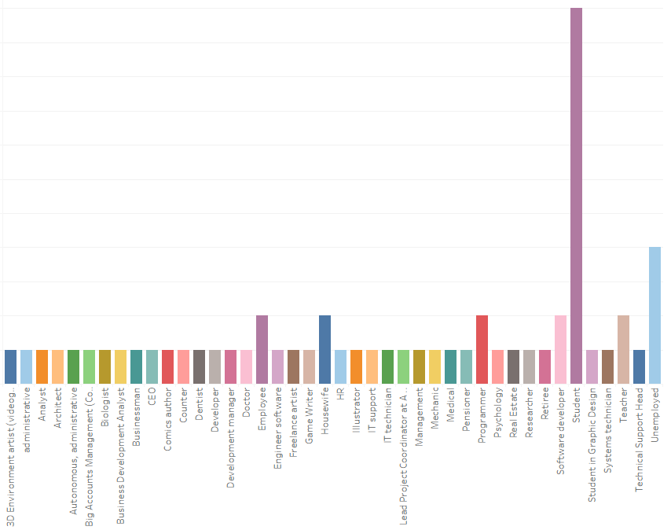
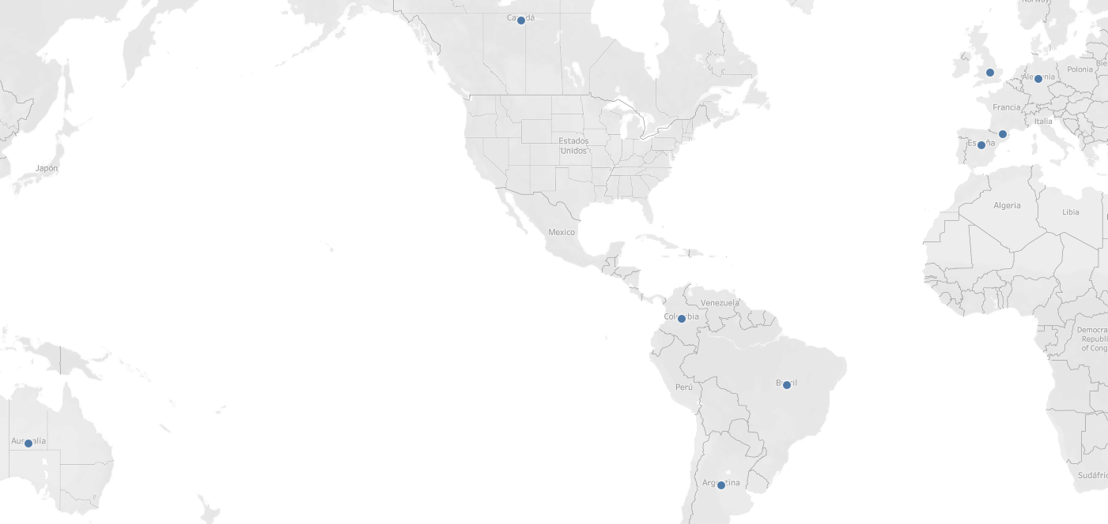
Demographic
We received survey responses from people around the world, covering a wide range of ages, educational backgrounds, and professions. The survey was divided into two main parts.
The first section focused on gathering personal and contextual information about each participant’s daily life and environment.
The second part explored their perception and use of AI.

Slide 3
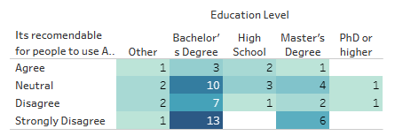
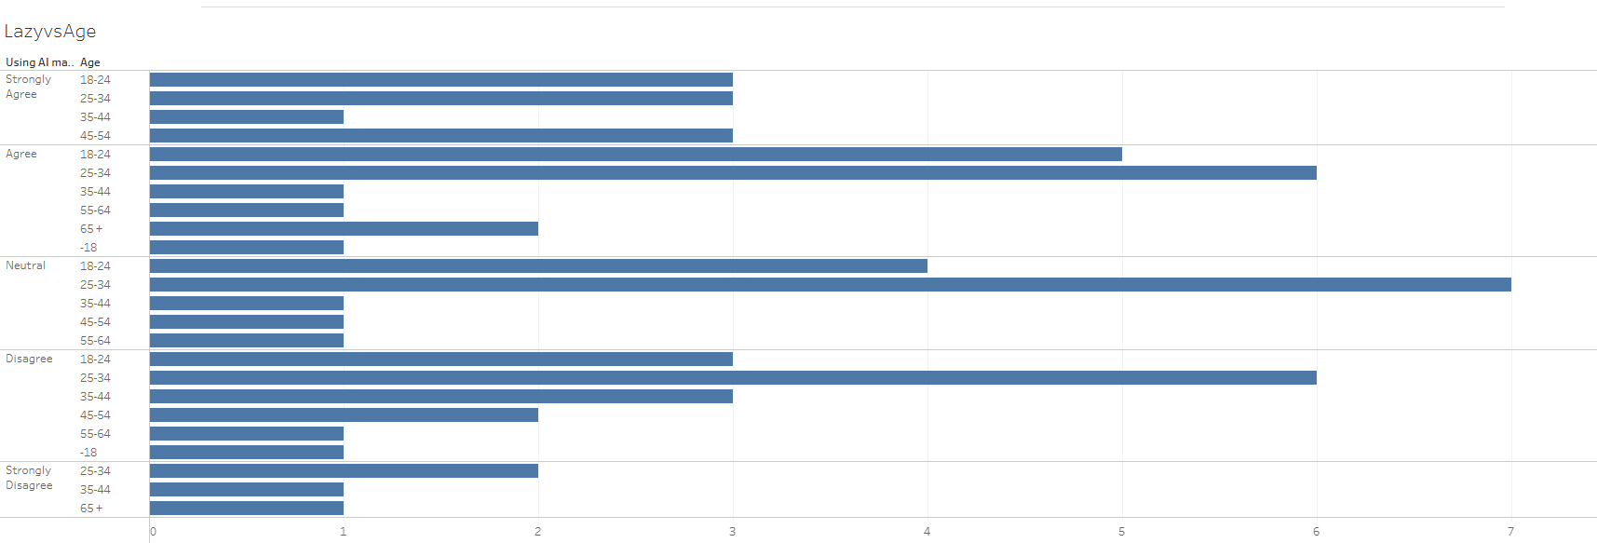

Slide 4
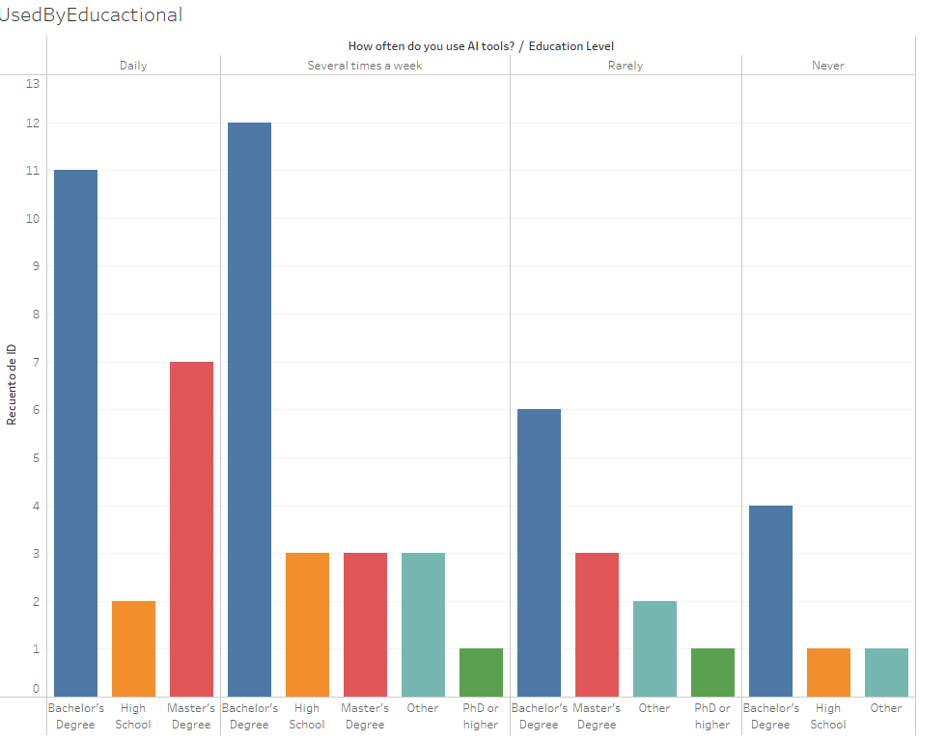

Slide 5
Hypothesis
People who use AI have a more lazy brain feeling → Failed
People who use AI tools more frequently are more likely to feel more confident in solving problems on their own without AI assistance. → Failed
Frequent users of AI tools are more likely to report being less stress → True with confidence of 98%

Slide 6
Ryff scale of psychological well-being
Dimension | Description
1. Self-Acceptance | Evaluating how one feels about oneself.
2. Positive Relations | Ability to maintain close interpersonal relationships.
3. Autonomy | Being independent and capable of resisting social pressures.
4. Environmental Mastery | Ability to manage life and the world around us.
5. Purpose in Life | Having goals and a sense of direction.
6. Personal Growth | Sense of ongoing development and openness to new experiences.

Slide 7
Liketr Notation
Scale Point | Label
1 | Strongly Disagree
2 | Disagree
3 | Neutral
4 | Agree
5 | Strongly Agree

Slide 8
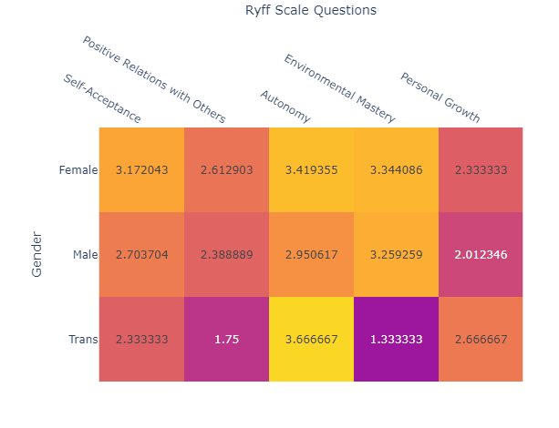

Slide 9
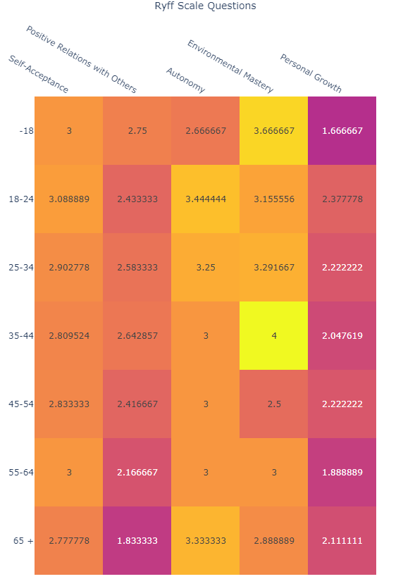

Slide 10
Conclusion
This study suggests that frequent use of AI tools may be quietly influencing how people feel about their own judgment and emotional independence. By focusing on well-being rather than just productivity, this approach offers a different way to think about AI's role in everyday life. It’s a small but important step toward understanding how we can use these tools without losing touch with our own instincts and confidence.

